Slide 1
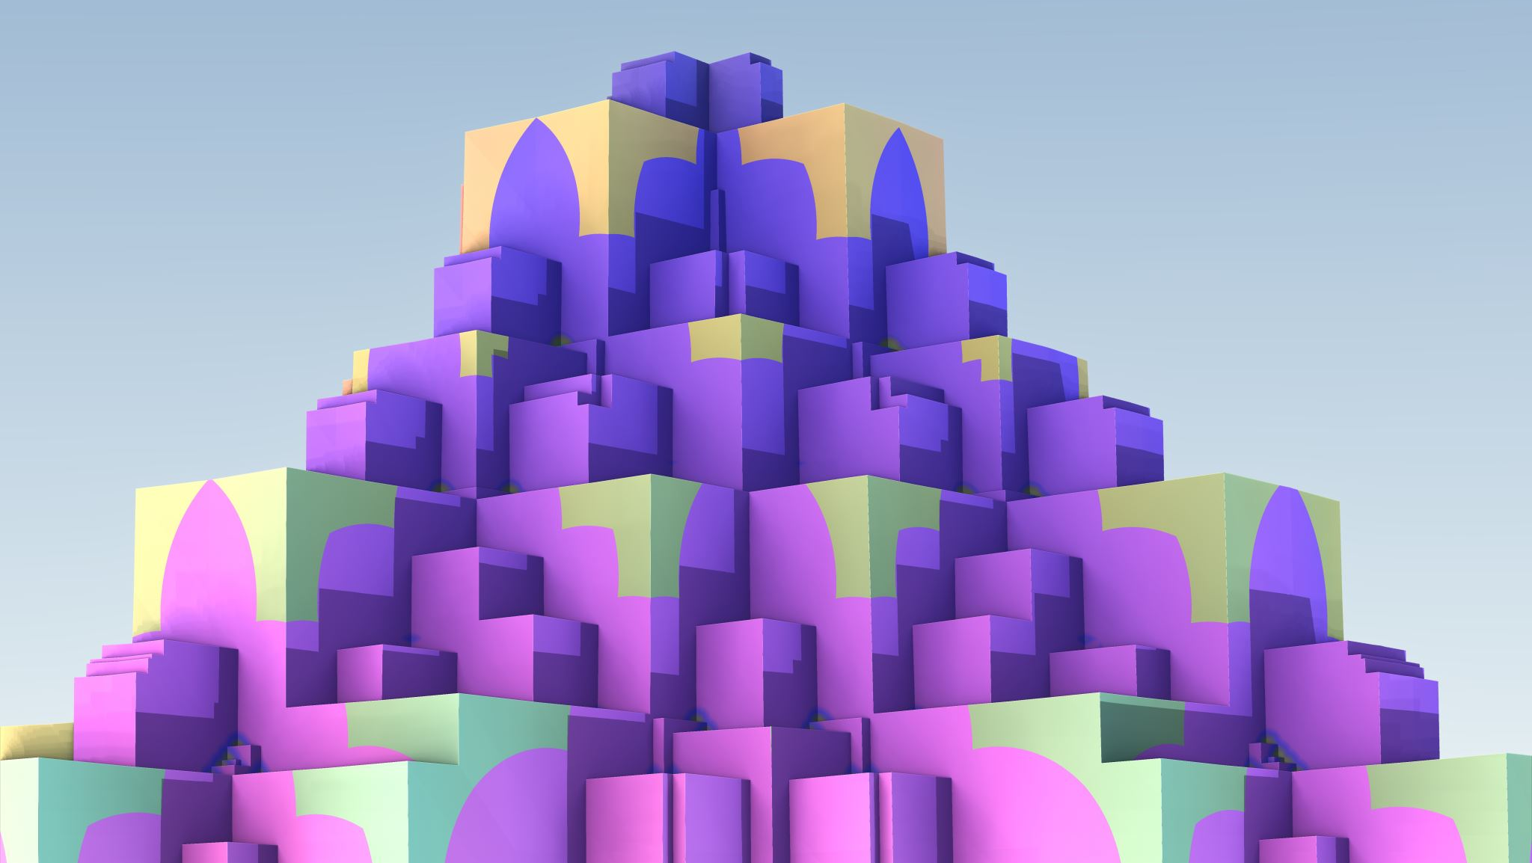
Identifying Inconsistencies and Incompleteness in Documents
Better Documents

Slide 2
Problems with Transformers
You train all at once. You do not incrementally add knowledge. You do not refine knowledge, e.g. going from letters to upper case and lower-case letters.
You cannot find knowledge. It is diffuse. Based on what I have read it is not even concentrated.
There is no explainability of how a dcsion is made.
Proposed alternative:
Frames
Frames created by transformers
Frames curated by transformers as new knowledge appears

Slide 3
Documents
Documents need to be (I need to get a source for this)
Consistent
Complete
Correct
Knowing if a document is correct requires knowledge beyond the scope of the documents
Checking for Consistency and Completeness can be done within the scope of the document of documents

Slide 4
Principles
Everything is in a Neural Network – no special memory or processing, except for input and output
Create specialized neural networks for specialized purposes

Slide 5
Typical LLM
The Internet
Training
Training
Prompt
Trained Neural Network
Response
Use
Local Database

Slide 6

Notes
This is based on Transformers
Training takes a long time and is only done occasionally
Work is progressing to address shortfalls: add new knowledge, reducing hallucinations
It is a Prompt / Response model. Not a conversation.

Slide 7
Proposed Architecture
The Internet
Training
Training
Long-Term Memory Neural Network
Memory Formation Neural Network
Use
Response Processing Neural Network
Input Processing Neural Network
Prompt
Input Memory Neural Network
Response

Slide 8
Notes
The Prompt Processing, Memory Formation, and Response Processing Neural Networks are Innate parts and do not change much if at all.
The Input Memory and Long-Term Memory Neural Networks change rapidly
Long-Term Memory is organized in some form of Frame. Empty slots provide the Response Processing with opportunities to ask questions
If a question is placed in Input Memory, the Response Processing seeks to answer it.

Slide 9
Notes
Memory formation considers repetition, recency, and relative location to form memories.
There is probably a need to continually review and update memories. Some relationships may not be apparent when information is first seen.
Everything is done in Neural Networks. This follows the design pattern of nature.
There are specialized structures of neural networks. This follows the design pattern of nature.

Slide 10
Why this architecture?
Ability to assimilate new knowledge.
Ability to explain which memories were used to develop a response.
Ability to hold a conversation.
To have goals (in this case, know what slots can be in a frame and the percentage they are used, drives a goal to fill slots)

Slide 11
Data
What data is needed for this?
How can I get the data?

Slide 12
Open Issues
There are two big open issues introduced by this architecture
How do we store memories in Neural Networks?
How do we form memories in Neural Networks?

Slide 13
How do we store memories in Neural Networks?
It is important to answer this question first. Since memories will need to be formed into the storage structure.
The starting point is a representation like Frames as described by Noam Chomsky
An isolated group of neurons can stand for a frame.
Each neuron in the frame can connect to another frame or a (value), these are slots

Slide 14
How do we store memories in Neural Networks?
We want single neurons to represent things like
A door
A car
Any car
The wheel of a car
There are relationships between things
Type of – A car is a type of any car
Part of – A wheel is a part of a car
Relationship – A car drives on a road
We need to distinguish classes of things from instances of things

Slide 16
How do we form memories in Neural Networks
Is a GNN the answer?
We could label the edges
Slot
Slot – Input
Slot – Output
Slot – Frame
Slot – Value
Slot – Parent Type
Slot – Name
How do we train a NN to convert text to Frames and Slots in a GNN?
How do we train a NN to improve Frames and Slots in a GNN?
How do we train a NN to identify inconsistency and incompleteness in Frames and Slots in a GNN?

Slide 17
Frame Example
Here we have a very simple frame example for the word bag
The Word and Letter frames are abstract
The bag frame is a type of the Word frame
The a, b, and g frames are all types of the Letter frame
The Word frame instances have 1 to N slots of type Letter
The Letter frame instances have one or more INPUT slots and one or more OUTPUT slots
Should there be slots for before, after, above, below?
Word
Letter
LETTER 1 P
INPUT X
Frame Name
LETTER N P
OUTPUT X
Parent Frame
Slot Frame
bag
Slot Value
a
b
g
INPUT a
INPUT b
INPUT g
OUTPUT a
OUTPUT b
OUTPUT g

Slide 18
Frame Example
Here we have a very simple frame example for the word bag
The Word and Letter frames are abstract
The bag frame is a type of the Word frame
The a, b, and g frames are all types of the Letter frame
The Word frame instances have 1 to N slots of type Letter
The Letter frame instances have one or more INPUT slots and one or more OUTPUT slots
Word
Letter
LETTER 1 P
INPUT X
LETTER N P
OUTPUT X
I first thought of having a Lower Case and Upper-Case sub type of Letter, but they need to be closely associated. So, they should be slots. Slots may need to have types.
Frame Name
Parent Frame
a
b
g
Slot Frame
bag
Slot Value
INPUT A
INPUT B
INPUT G
INPUT a
INPUT b
INPUT g
OUTPUT a
OUTPUT b
OUTPUT g

Slide 19
Frame Example
Here we have a very simple frame example for the number 10
The Number and Digit frames are abstract
The 10 frame is a type of the Number frame
The 0, 1, and 2 frames are all types of the Digit frame
The Number frame instances have 1 to N slots of type Digit
The Digit frame instances have one or more INPUT slots and one or more OUTPUT slots
Should there be slots for before, after, above, below?
Number
Digit
INPUT X
Frame Name
OUTPUT X
Parent Frame
Slot Frame
10
Slot Value
0
1
2
INPUT 0
INPUT 1
INPUT 2
OUTPUT 0
OUTPUT 1
OUTPUT 2

Slide 20
Input
Neural Networks
Input Processing
Text
Text Processing
Sound
Sound Processing
Common Processing
Memory Formation
Video
Video Processing
These neural networks are essentially hard coded.
Pictures
Picture Processing

Slide 21
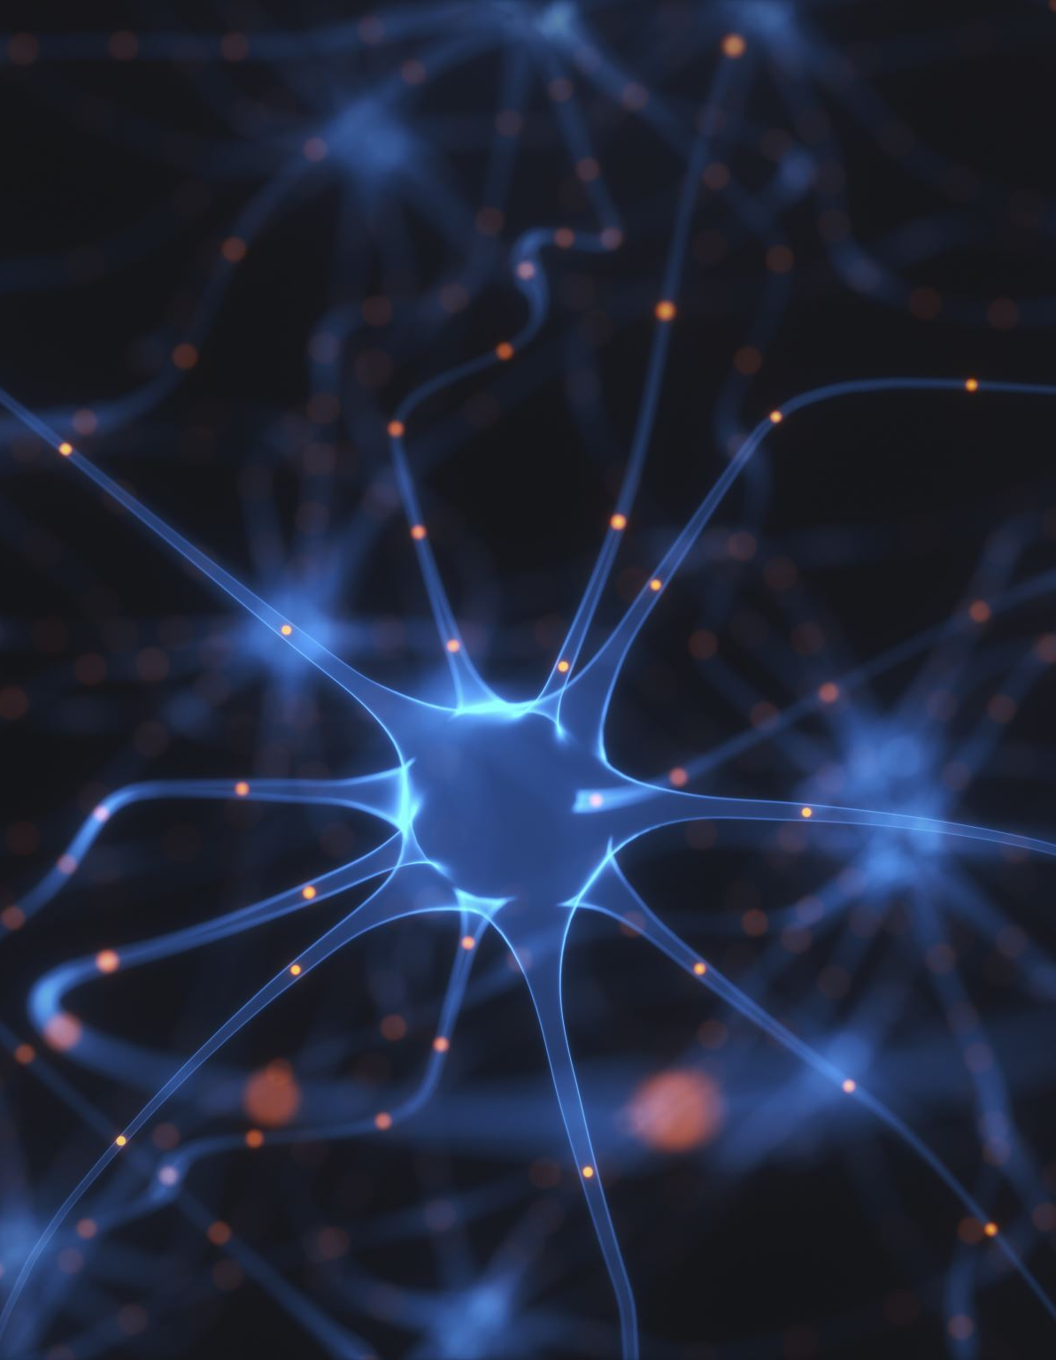
Open Questions
Why am I doing this?
What is the interface between different neural networks?
What is the difference between a hard coded (innate) neural network and one that can be trained?
How do we arrange neural networks so that they can form frames?
How do we address focus? A human only focuses on a small part of any visual scene.

